Slide 1
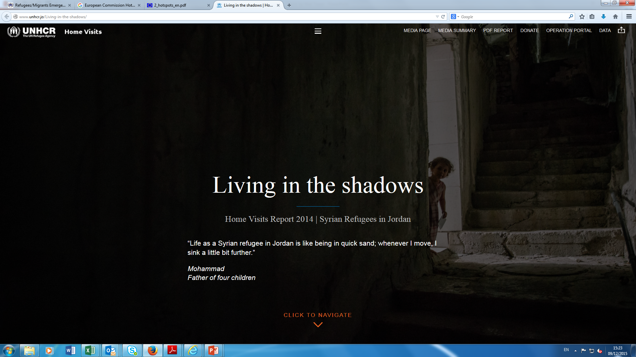

Regional Refugee and Migration Response Plan
Sample Header
NB IOM Logo should be white, rather than blue

Slide 2
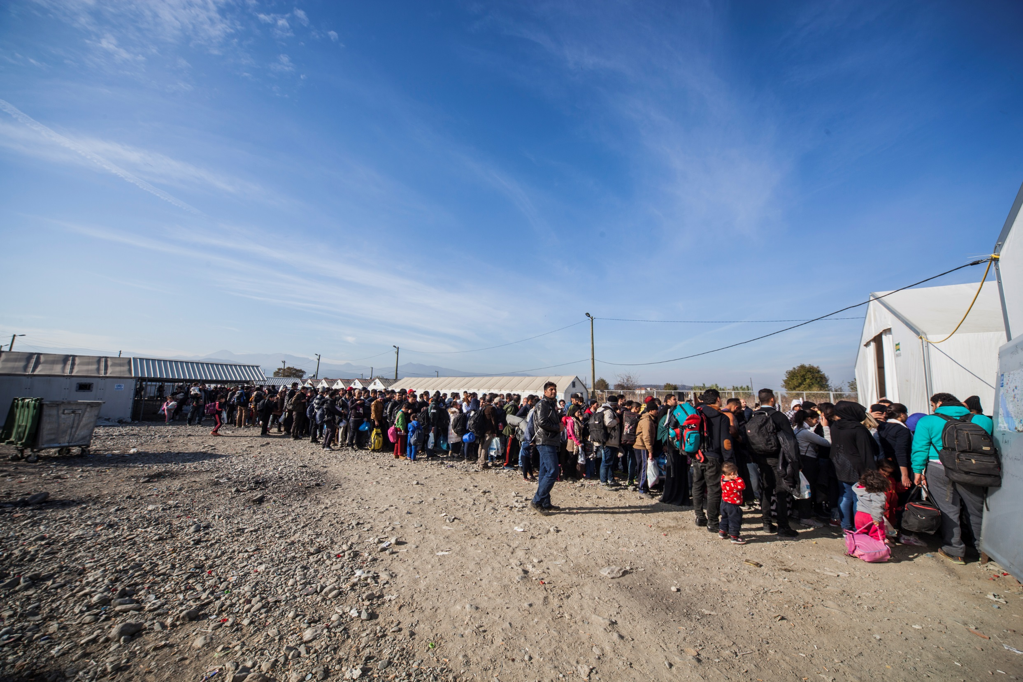
REGIONAL REFUGEE AND MIGRATION RESPONSE PLAN 2016

Slide 3
Slide with Europe Map from portal

Slide 4
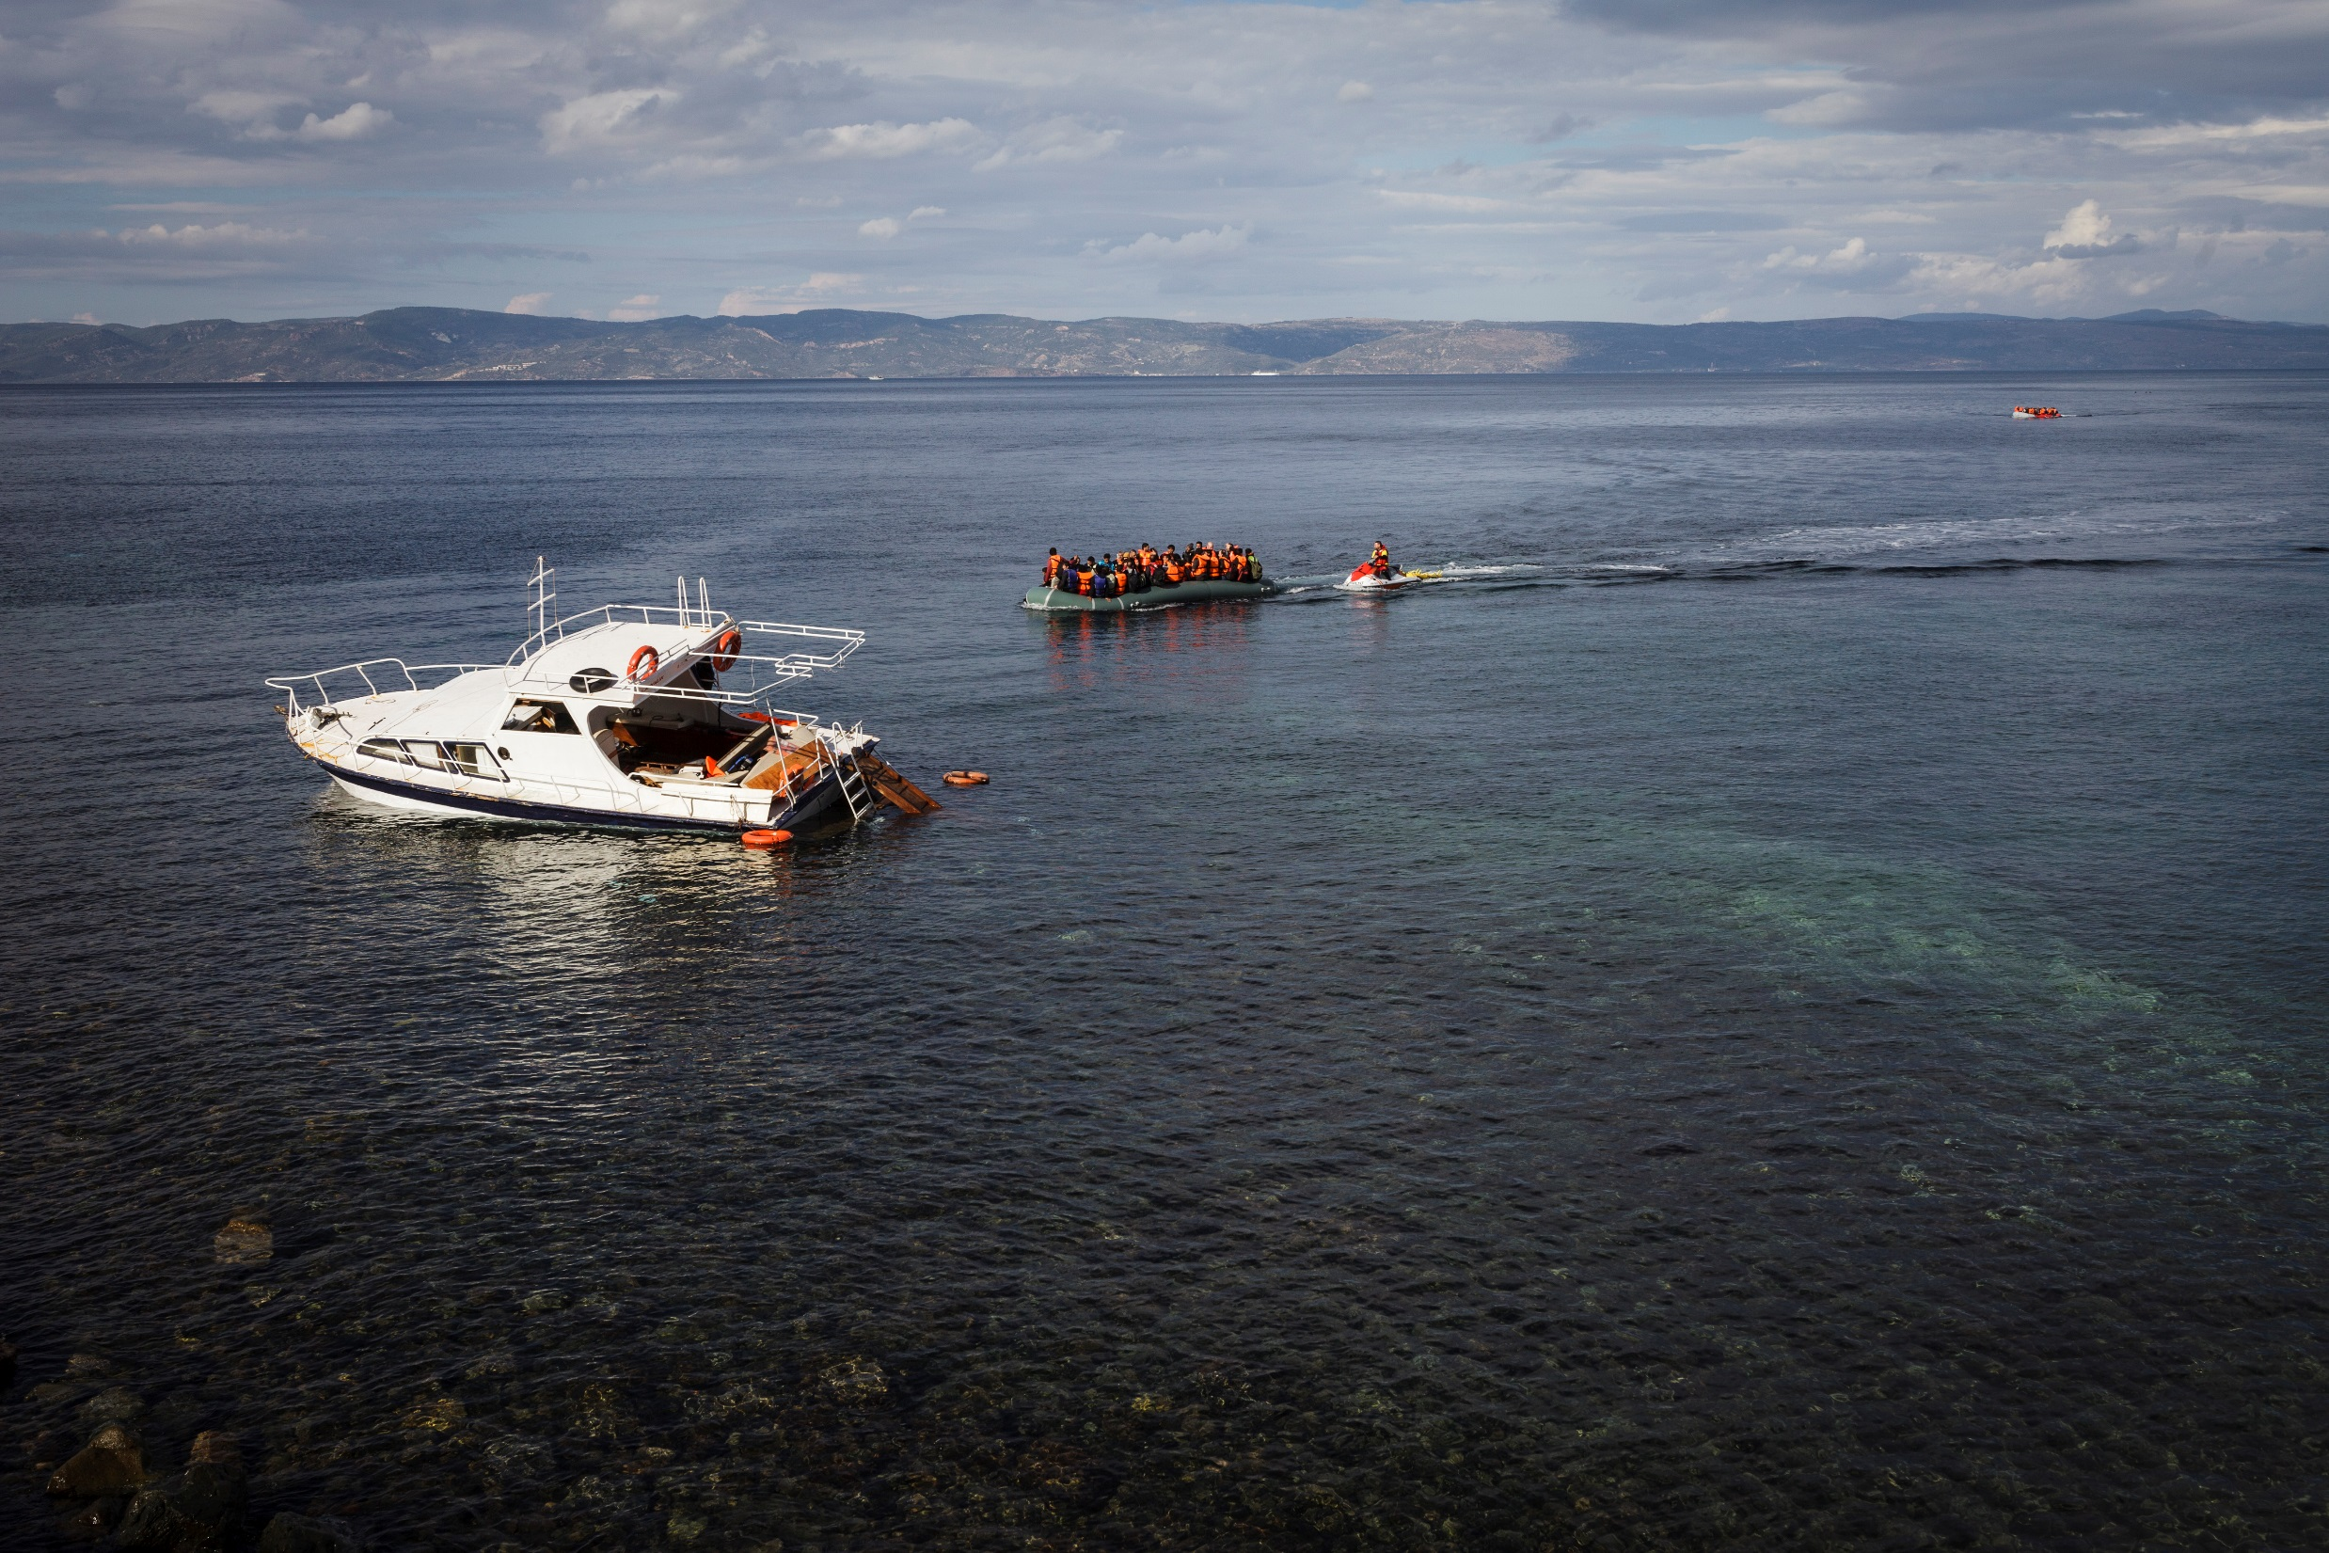
In 2015, 921,713 men, women, boys and girls have made the hazardous journey to Europe.
The majority are refugees fleeing war-torn countries.
84% originate from Syria, Iraq and Afghanistan.

Slide 5
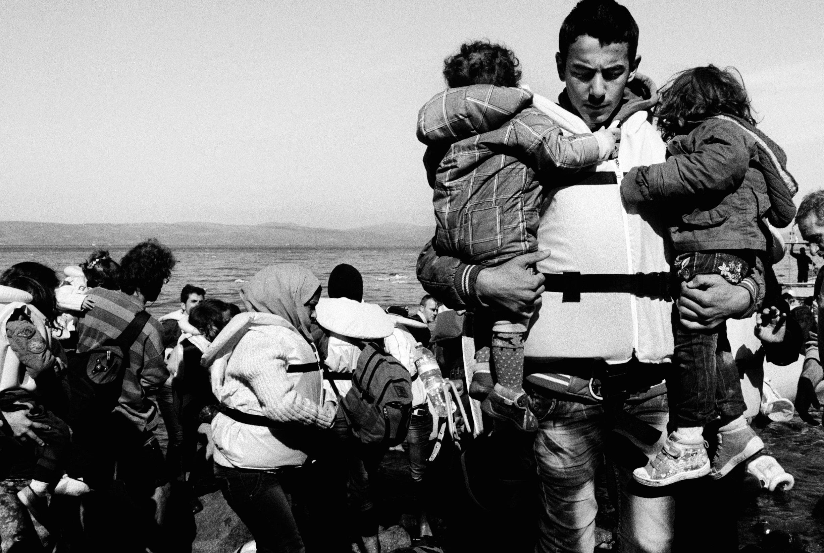
Whole families are fleeing the fighting.
[add caption / figure]

Slide 6
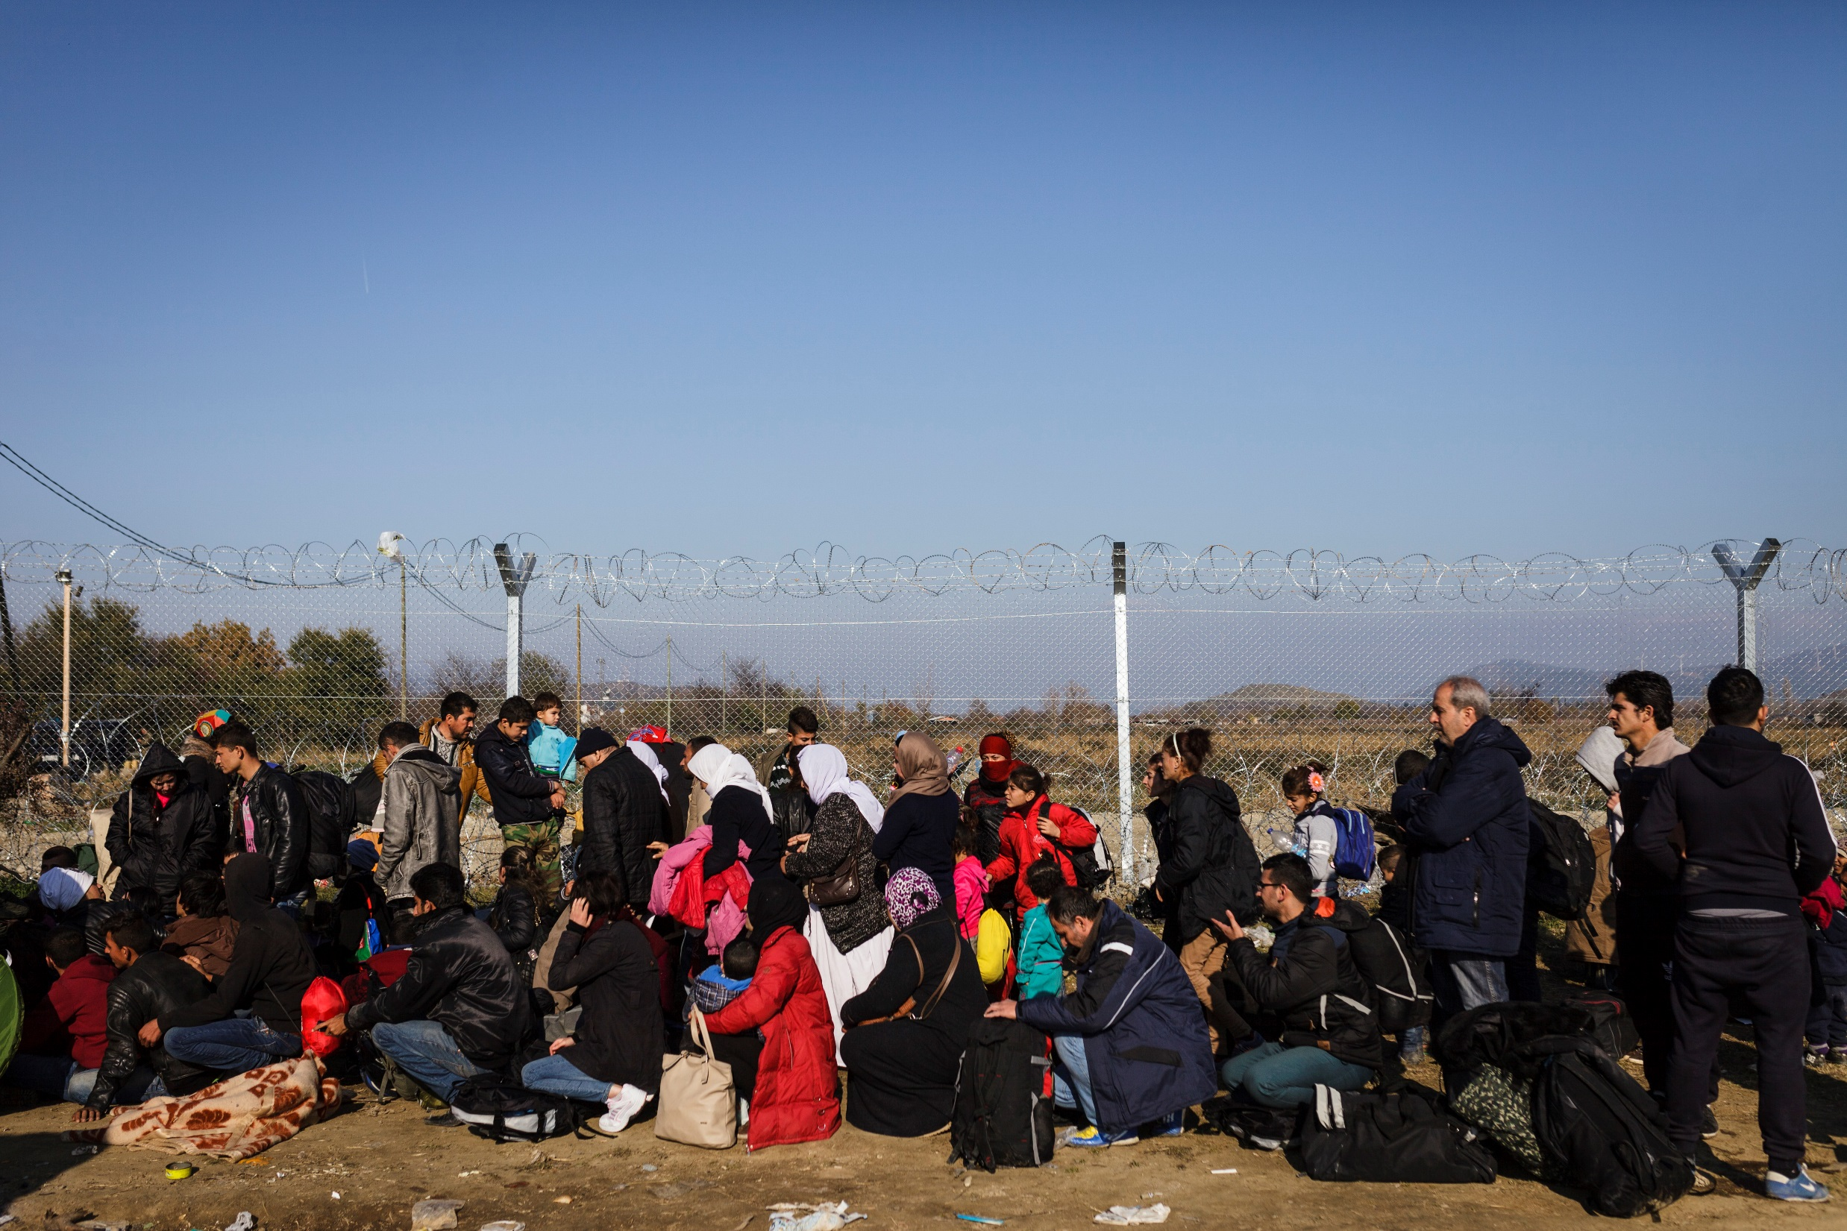

Slide 7
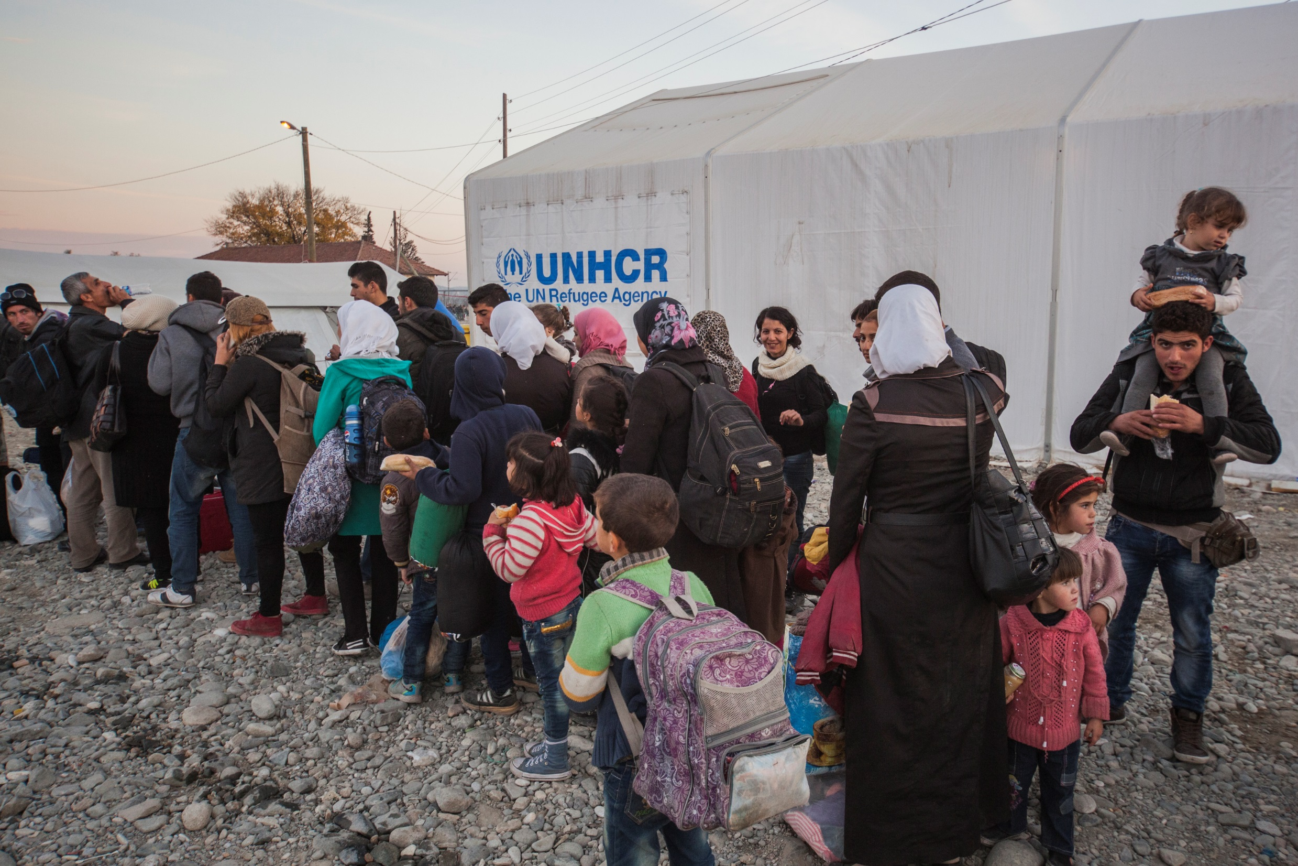

Slide 8
